Slide 1
Olympics Data Analysis
Presented by: Ashok Nagar
Tools: Python, Pandas, Seaborn, Matplotlib

Slide 2
Problem Description
Objectives of the Analysis:
• Explore trends and patterns in Olympics data over time.
• Identify country-wise and sport-wise performance.
• Analyze athlete demographics and gender participation.
• Understand medal distributions and highlight top performers.

Slide 3
Key Insights
1. USA has consistently dominated the medal tally.
2. Number of female participants has increased significantly over the years.
3. Athletics and swimming are the top medal-generating sports.
4. Young athletes are more prominent in gymnastics, while older ones dominate shooting and equestrian.
5. Host nations tend to perform better in their hosting years.

Slide 4
Conclusion & Recommendations
Conclusion:
Olympic performance is influenced by investment in sports, grassroots training, and gender inclusivity.
Recommendations:
• Promote equal opportunities for men and women in all sports.
• Identify and nurture talent from a young age.
• Leverage data to optimize performance and training strategies.

Slide 5
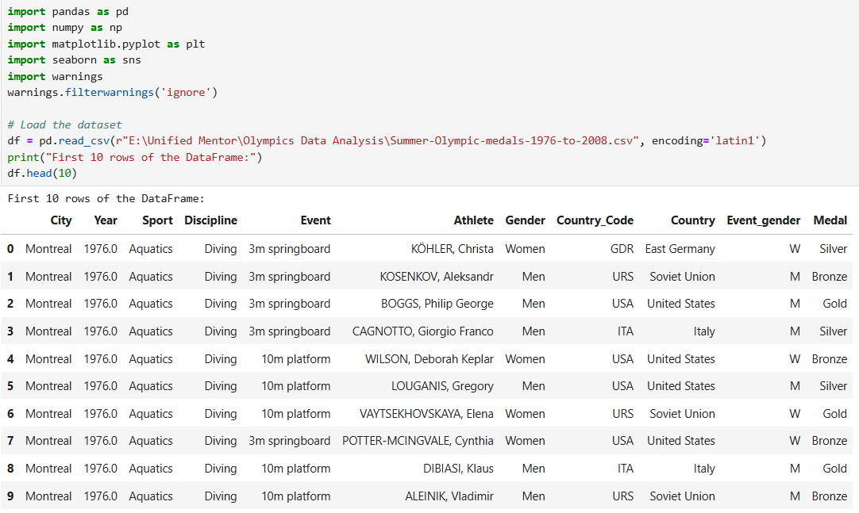
Python Code
Step 1: Data Preparation

Slide 6
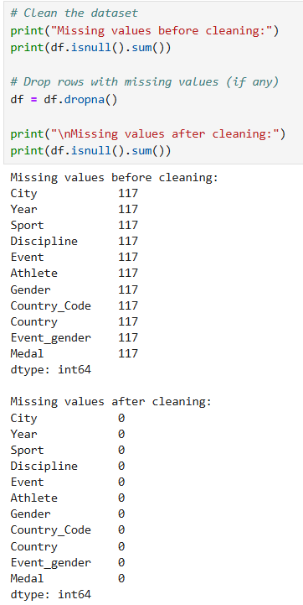
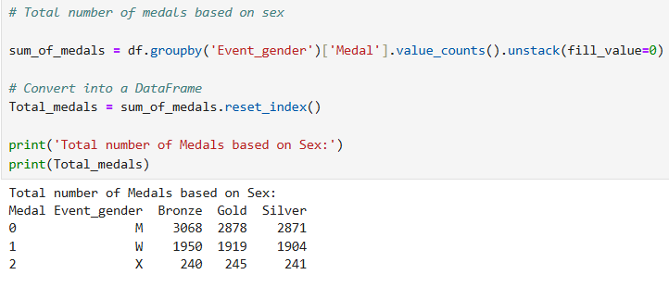

Slide 7
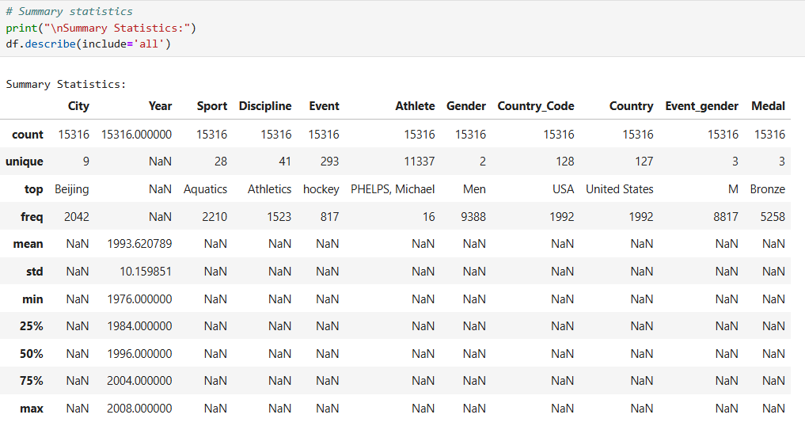
Step 2: Exploratory Data Analysis (EDA)

Slide 8
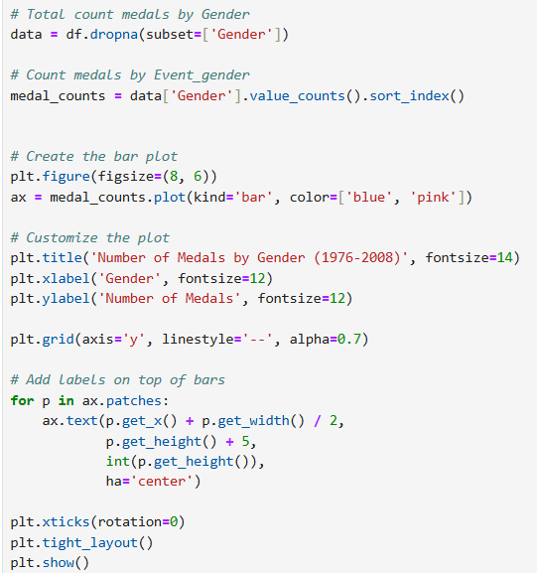
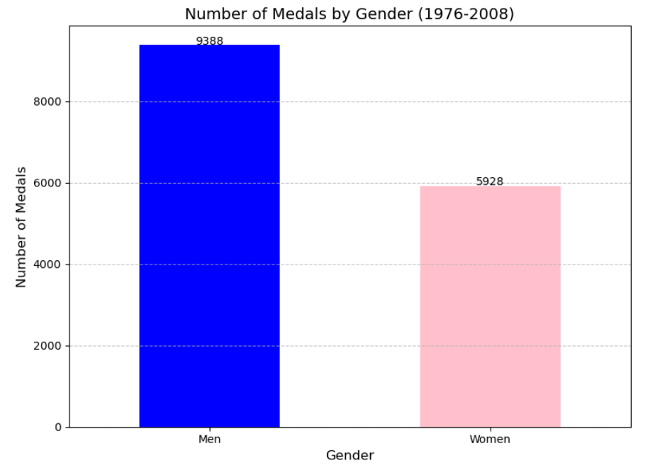

Slide 9
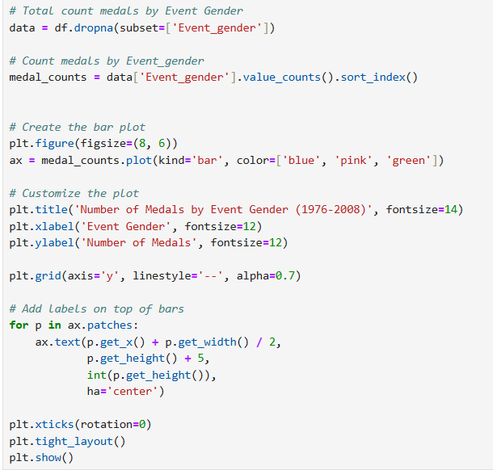
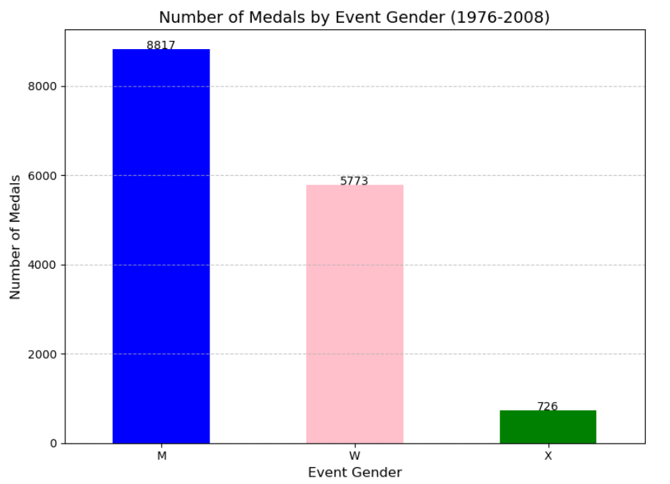

Slide 10
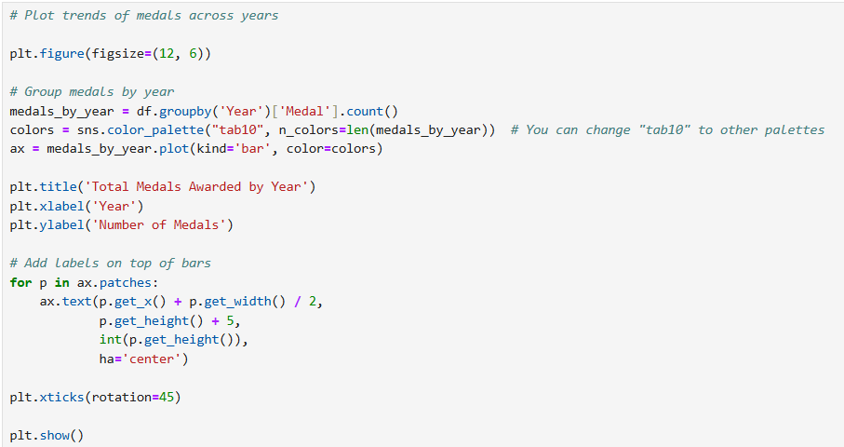
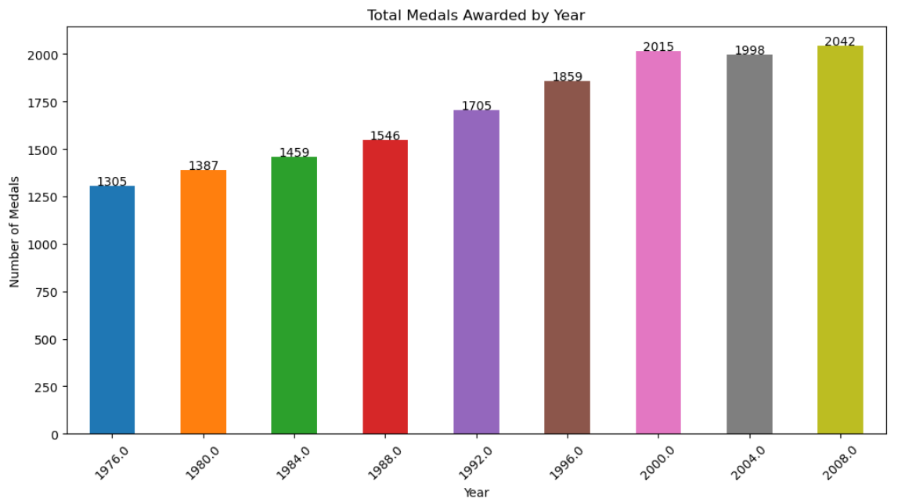

Slide 11
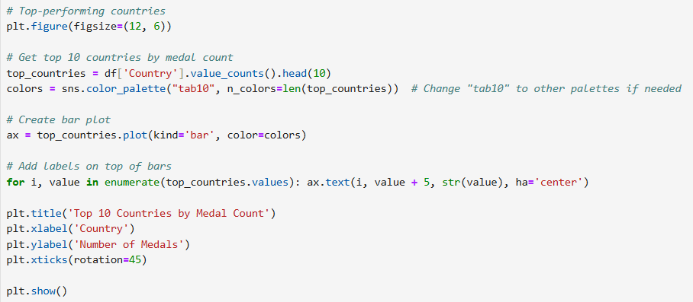
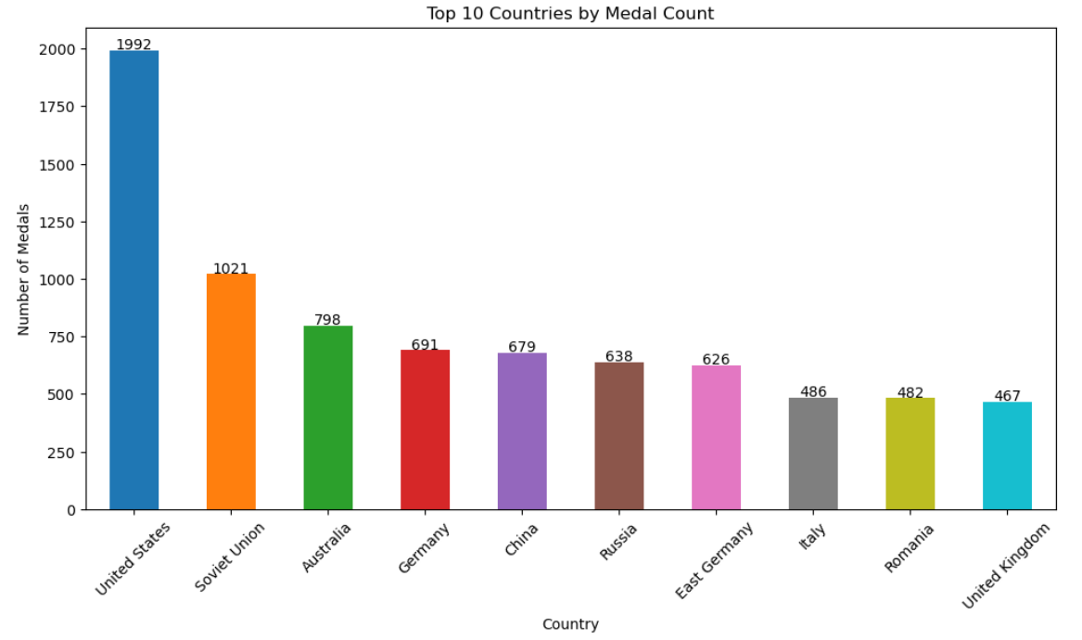

Slide 12
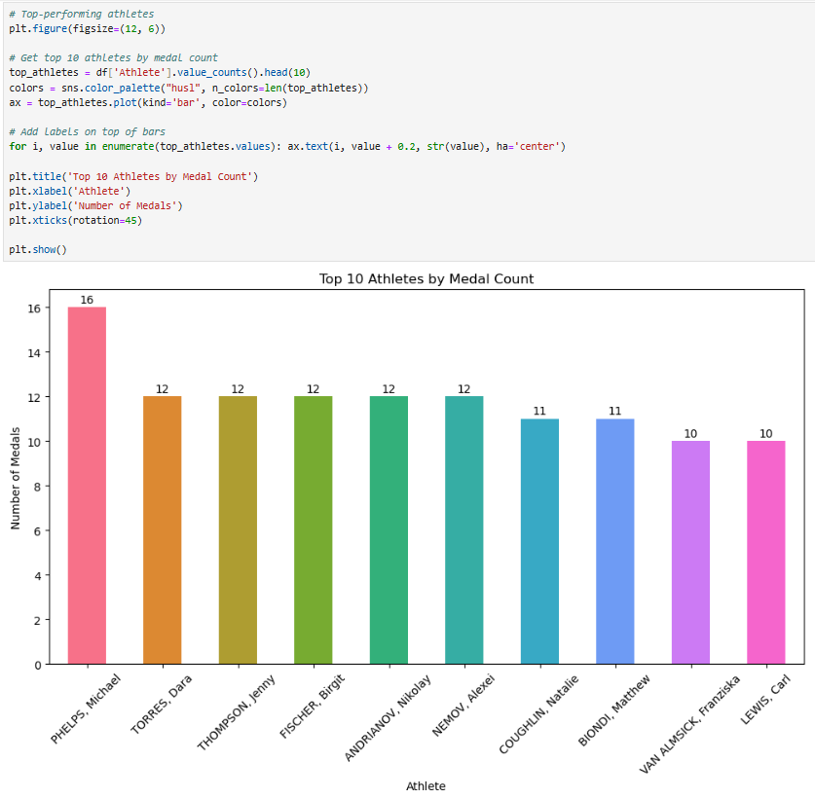

Slide 13
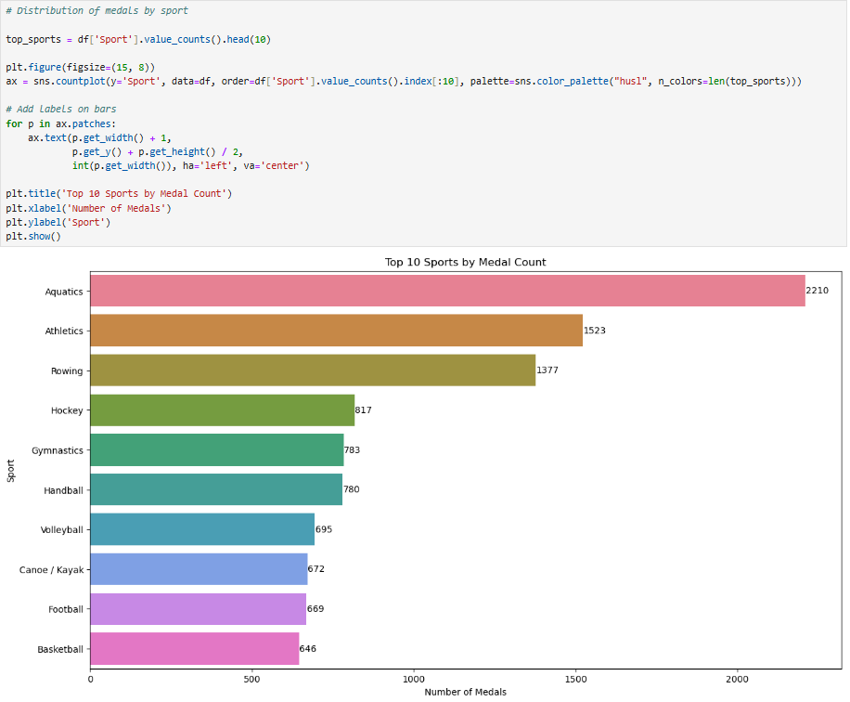
Step 3: Visualizing Key Insights

Slide 14
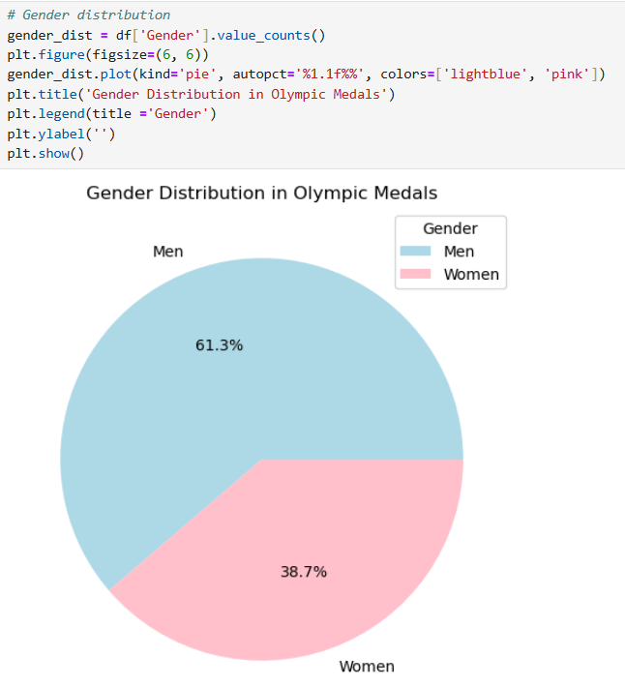

Slide 15
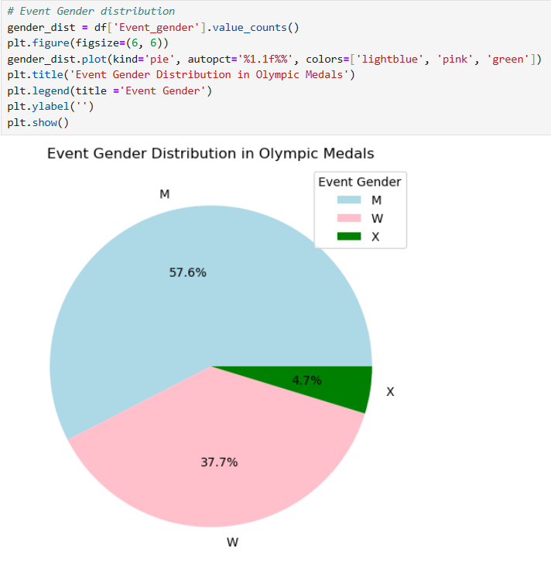

Slide 16
